Slide 1

Password Cracking

Slide 2

Machine Used
Kali Linux is the machine used.
People use Kali Linux for a variety of reasons, primarily related to its specialized focus on cybersecurity and penetration testing.
Kali Linux is a Debian-based Linux distribution that comes preloaded with a wide range of security tools and utilities.
Some of the key reasons why people use Kali Linux are PenTesting and Ethical hacking, Security Research and Education, Vulnerability Assessment, Password Cracking, Web Application Testing.
Kali Linux is designed to be accessible to a wide range of users, and it is available in various formats like ISO images and Virtual Machine images.

Slide 3
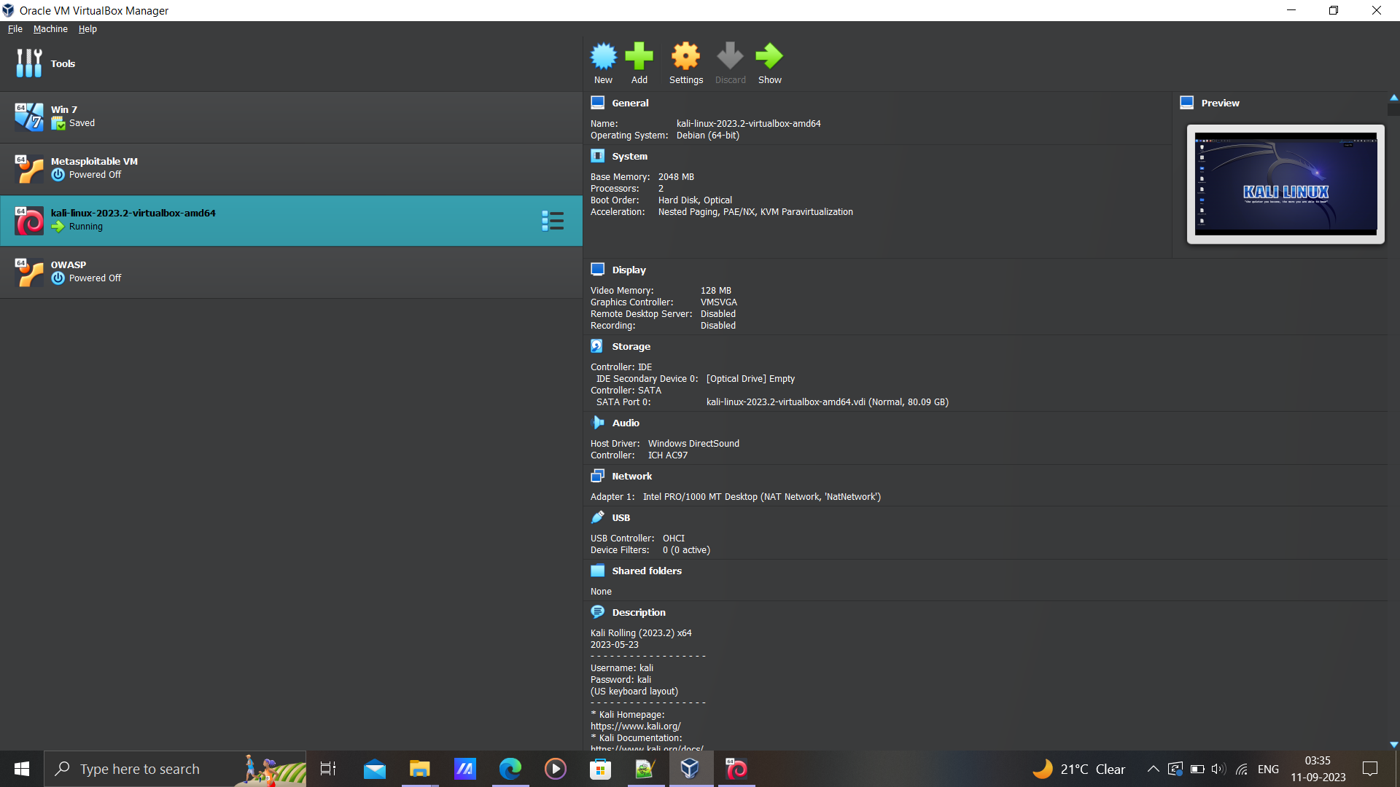

Slide 4

Tool Used
Burp Suite is a web vulnerability scanner and security testing tool commonly used by cybersecurity professionals for web application security assessments.
Web Application Scanning: Burp Suite can identify and report vulnerabilities in web applications, such as SQL injection, cross-site scripting (XSS), and more.
Proxy: Burp Suite acts as a proxy between a web browser and a web application, allowing users to intercept and modify HTTP requests and responses. This is helpful for manual testing and identifying potential security flaws.
Intruder: The Intruder tool in Burp Suite is used to automate various attacks, but it is not specifically designed for password cracking. It can be used for tasks like fuzzing, which involves sending a large number of specially crafted requests to find vulnerabilities.

Slide 5
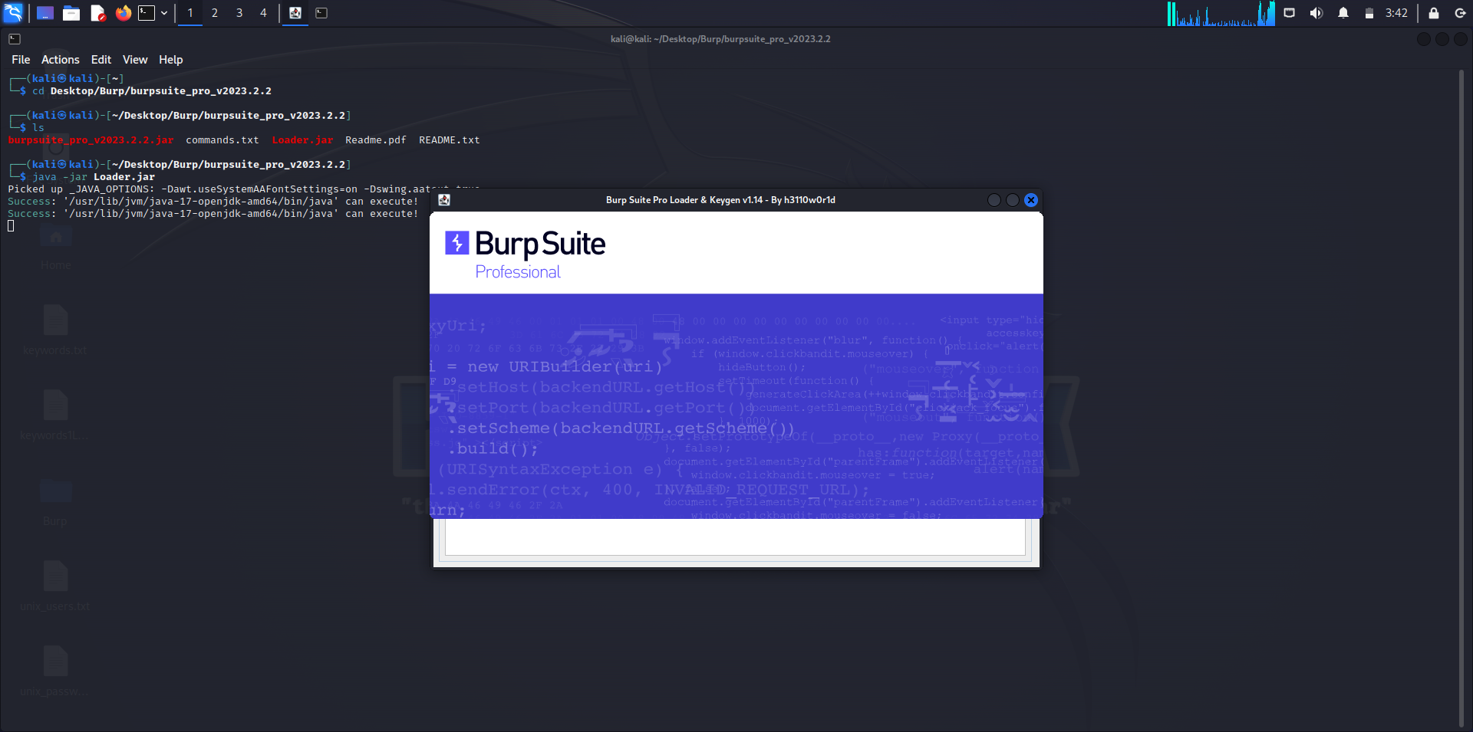

Slide 6

Target
The Login page of Mutillidae II is the victim of this attack. Password cracking on the login page of Mutillidae II or any web application for educational and testing purposes typically involves attempting to guess or crack the password of a user account using various techniques.
Mutillidae II, also known as "Mutillidae" is a deliberately vulnerable web application that is designed for educational and training purposes in the field of cybersecurity and web application security testing.
It is developed and maintained by OWASP (Open Web Application Security Project), a well-known organization focused on improving the security of software.
Mutillidae 2 is essentially a web application that contains a wide range of known security vulnerabilities, such as SQL injection, cross-site scripting (XSS), and more.

Slide 7
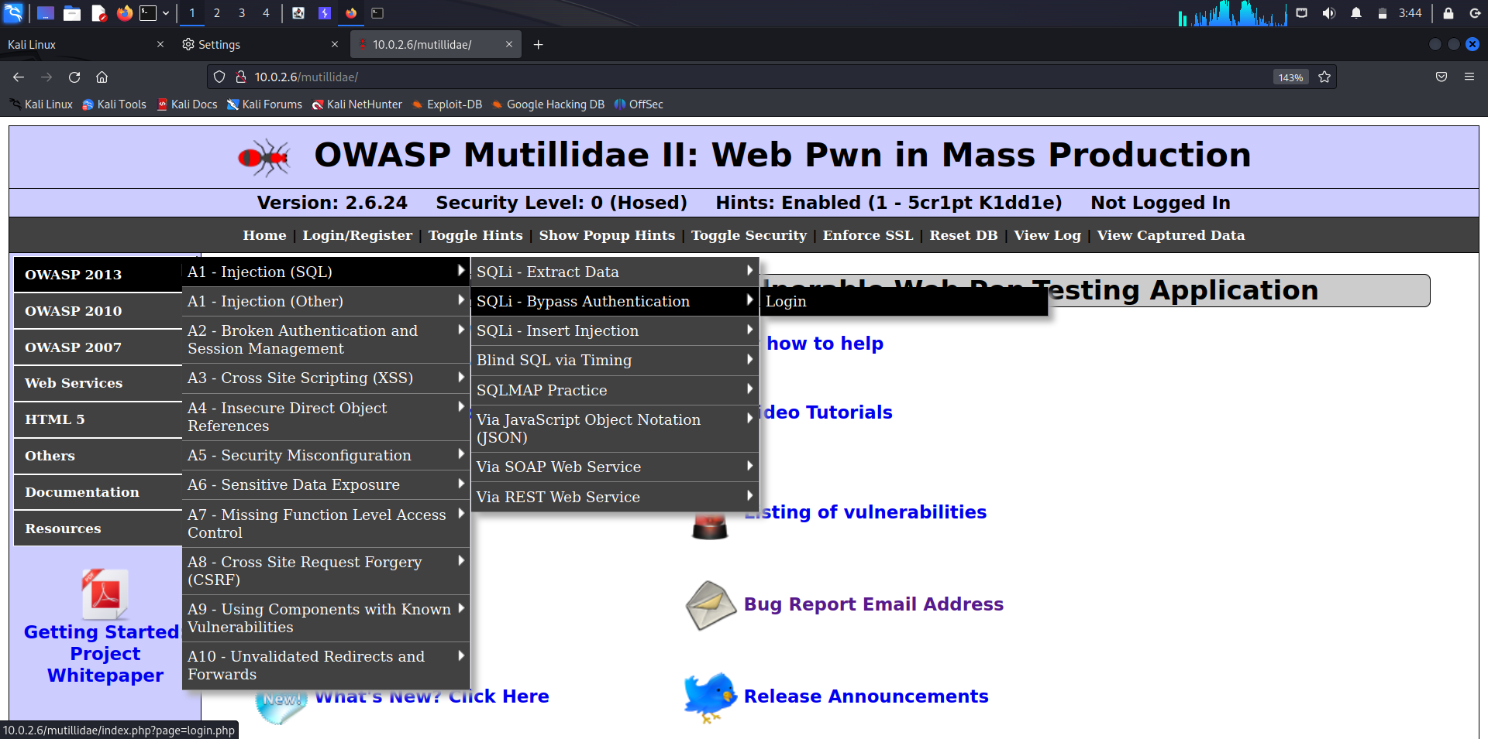

Slide 8
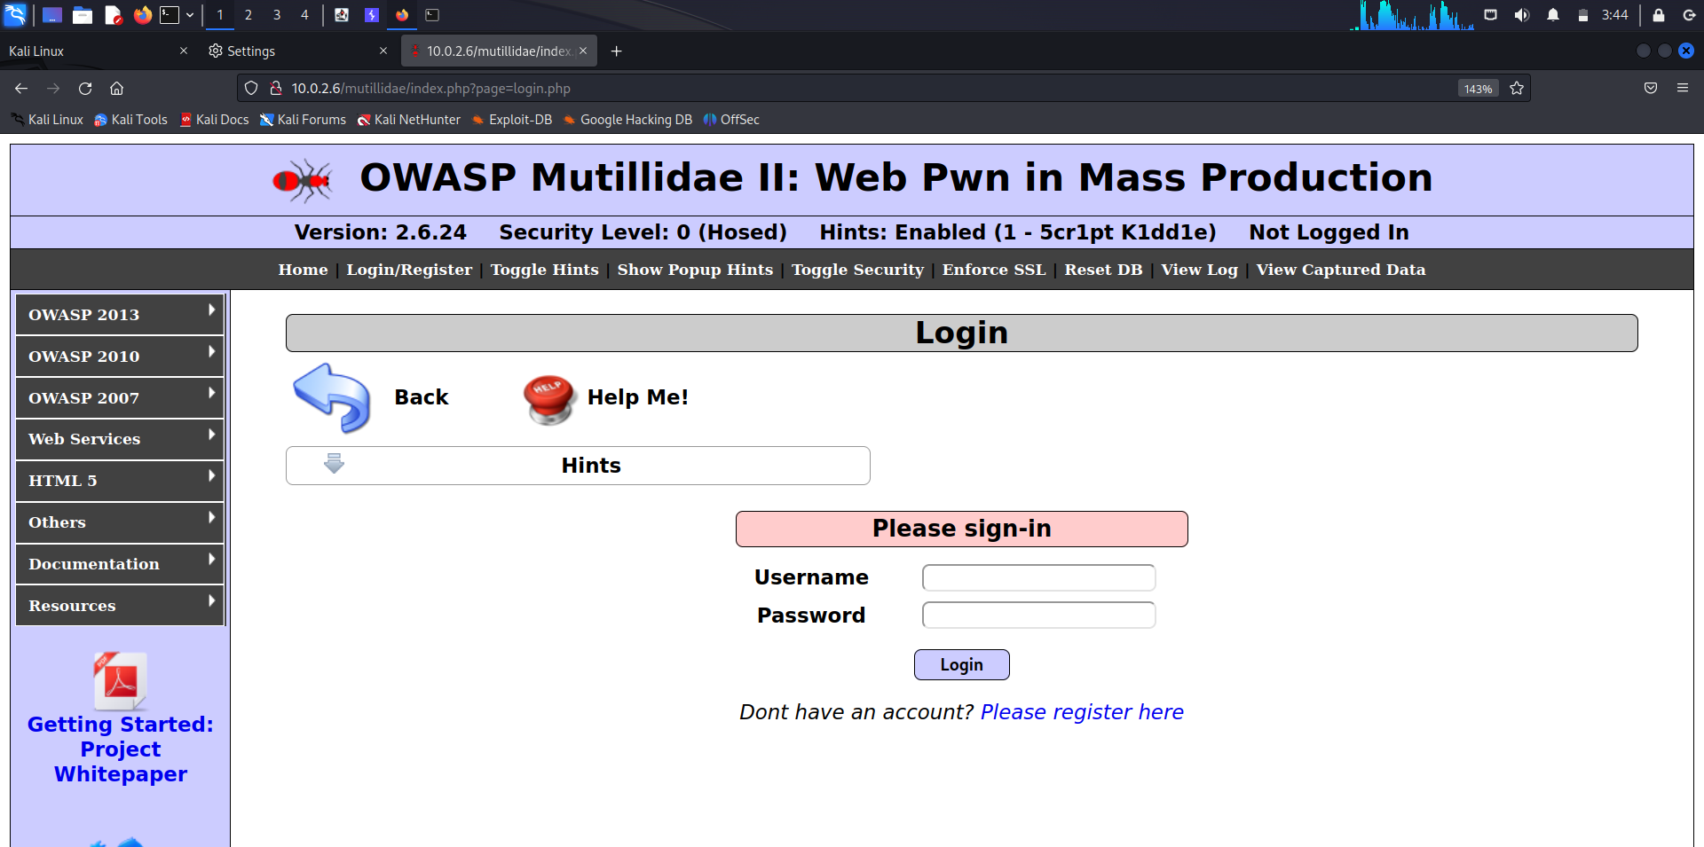

Slide 9
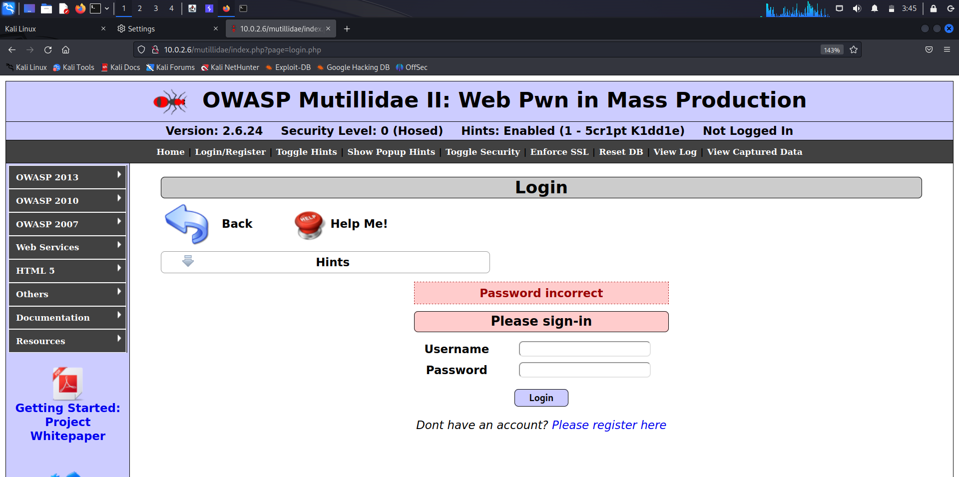

Slide 10

Parameter being attacked
The parameters we are attacking are both the username and password fields of the Mutillidae II web application's login page.
The type of attack we are going to perform is Dictionary attack, an attacker uses a list of common words or phrases (a "dictionary") to attempt login combinations.
When you have multiple parameters, such as both username and password, you are dealing with a more complex input space.
Here we employ Cluster bomb fuzzing, which involves generating a wide range of random or semi-random input combinations, can help explore various code paths and uncover unexpected vulnerabilities.
Since we have two parameters, we must have two different dictionaries for each username and password.

Slide 11
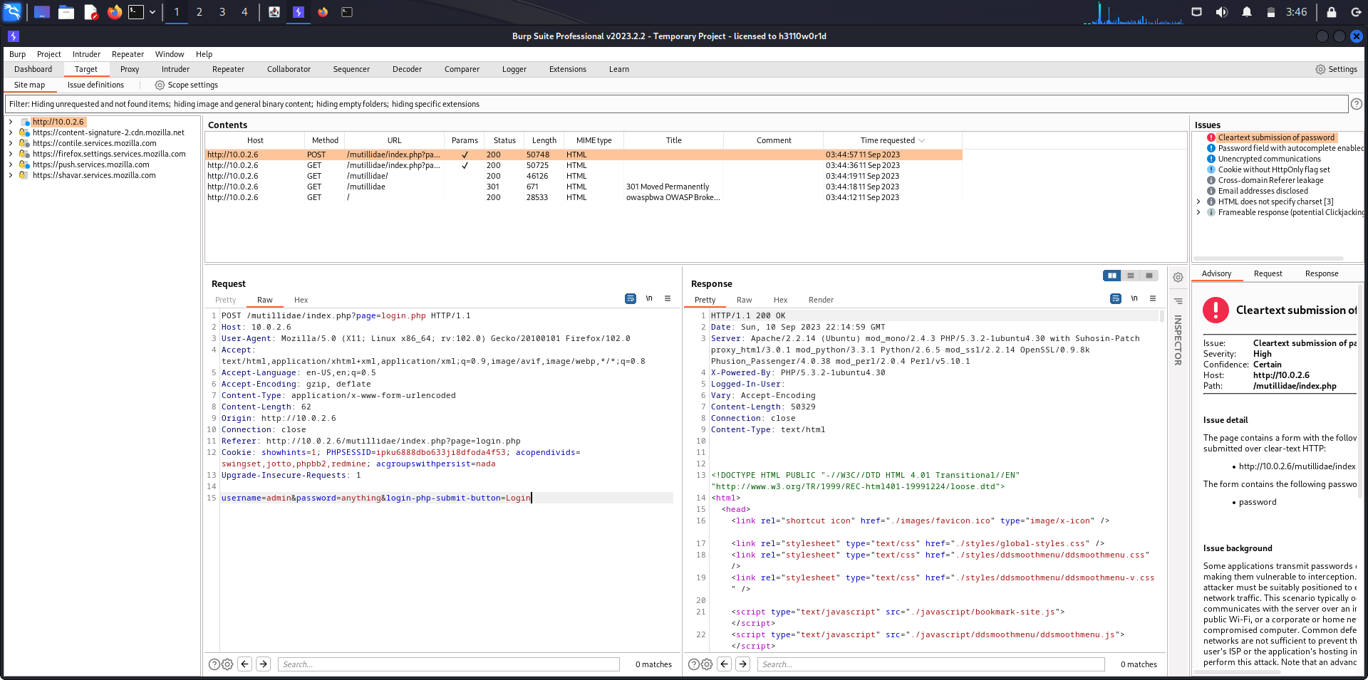

Slide 12
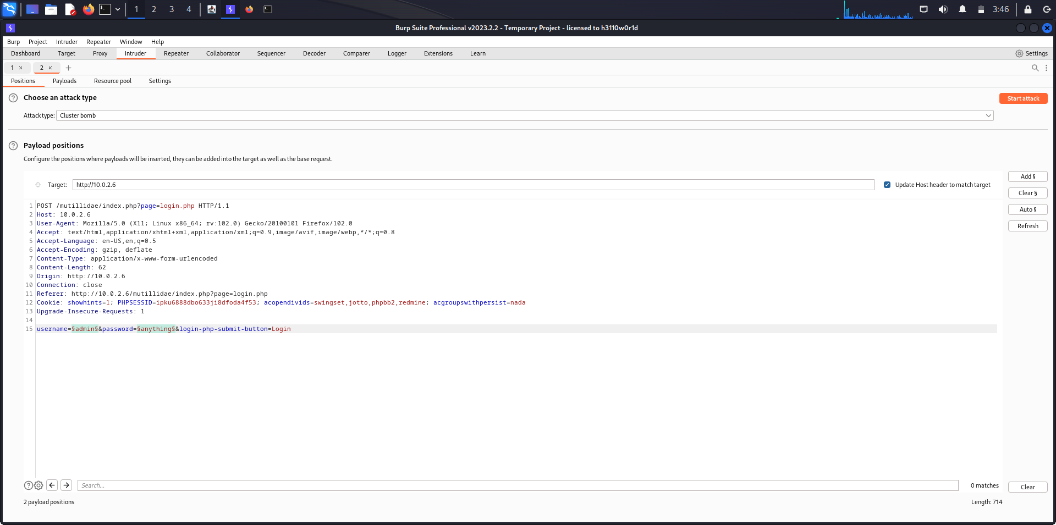

Slide 13
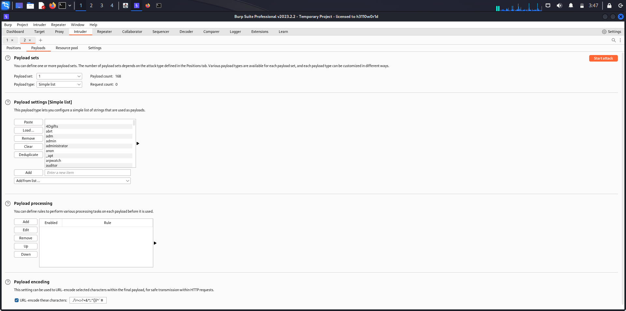

Slide 14
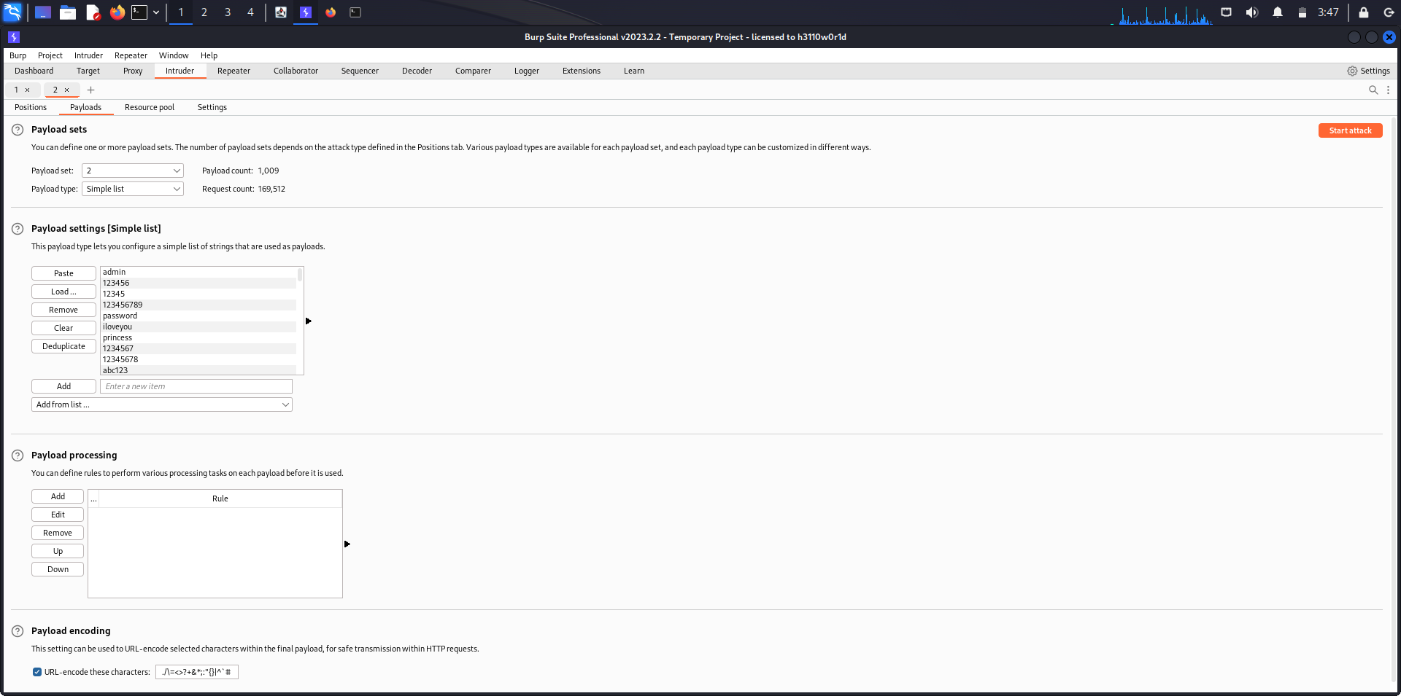

Slide 15

End Output
The end output of a password cracking attack on a login page can provide valuable insights and information about the security of the target system.
Cracked Credentials: The primary outcome of a successful password cracking attack is the list of cracked credentials. This information can be used to gain access to user accounts.
Success Rate: The end output should indicate the success rate of the attack, which is the percentage of cracked credentials out of the total attempted.
Time Taken: Information about the time it took to crack the passwords is crucial. This metric helps gauge the speed and efficiency of the attack.
Security Vulnerabilities: The output should highlight any security vulnerabilities or weaknesses identified during the attack.

Slide 16
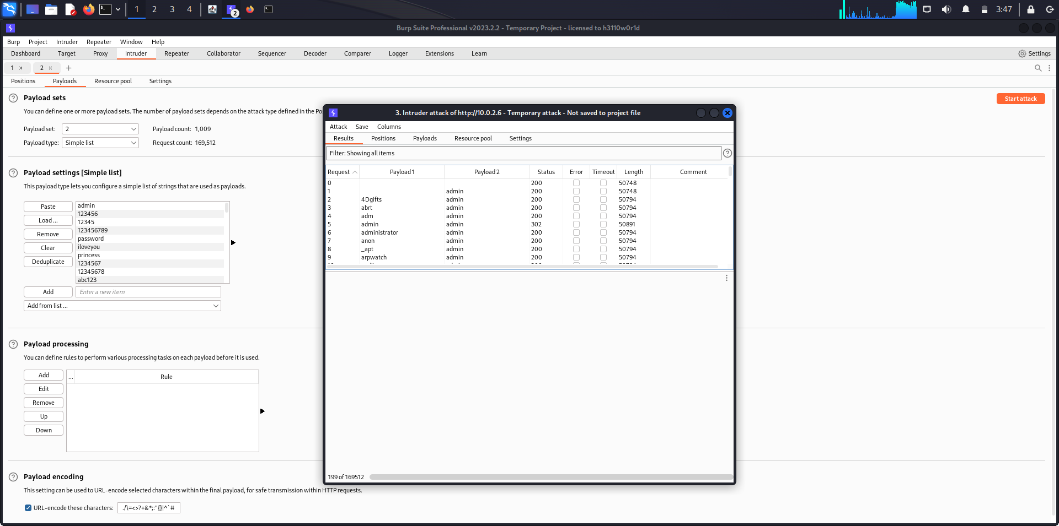

Slide 17
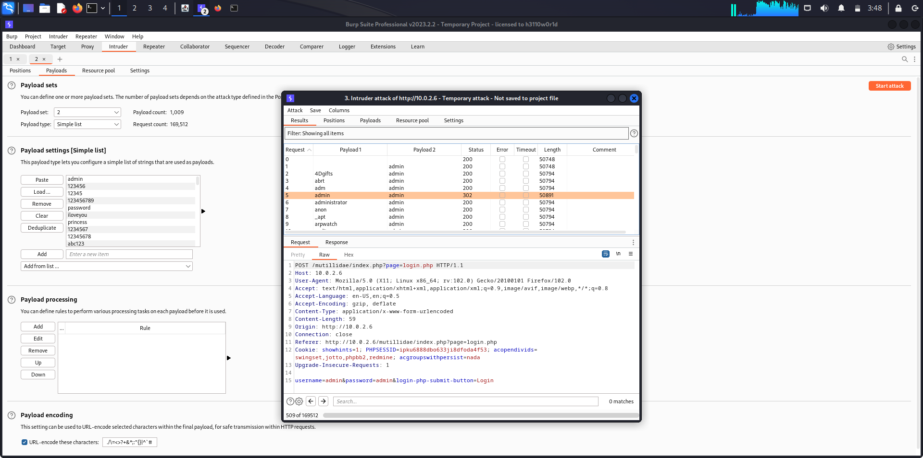

Slide 18
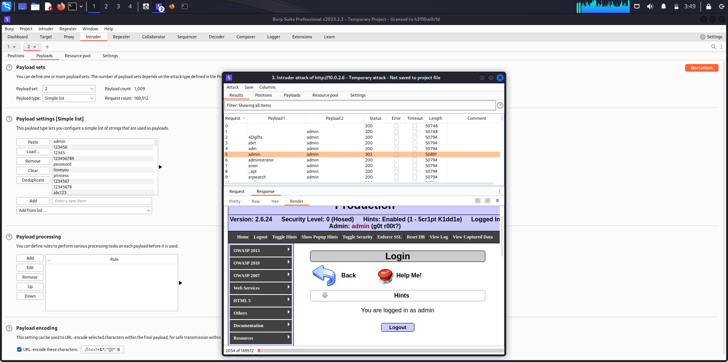

Slide 19
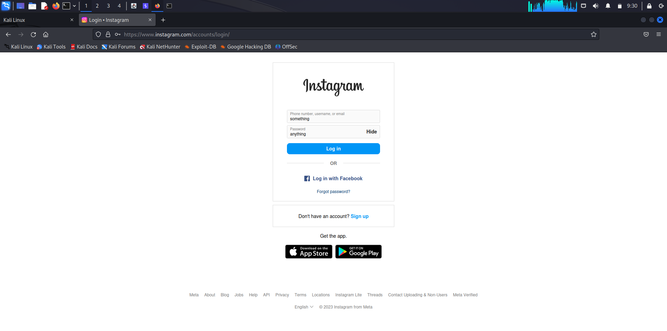

Slide 20
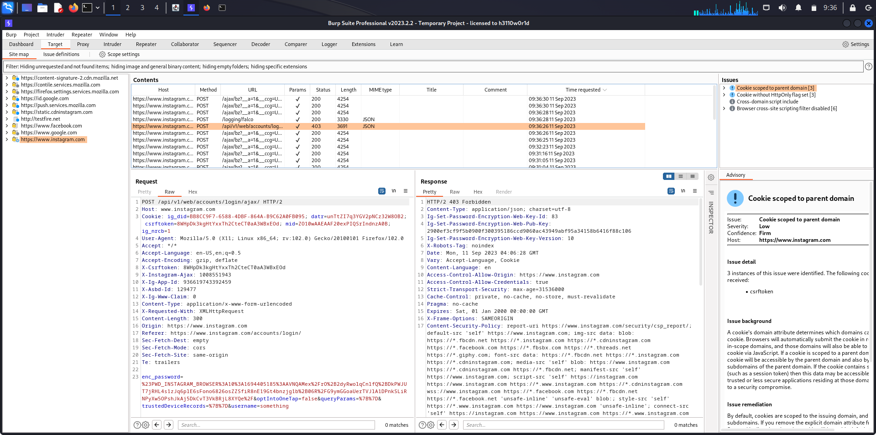

Slide 21

Thank You

